Slide 1
Basic of Data Structures
Mrs. Sonali V. Shinge

Slide 2
Definition
A data structure is a particular way of organizing data in a computer so that it can be used effectively.
A data structure is a specialized format for organizing, processing, retrieving and storing data.

Slide 3
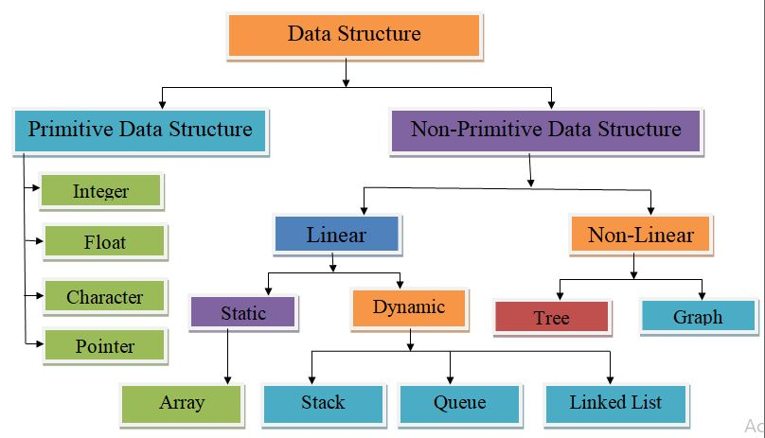
Types of Data Structures

Slide 4
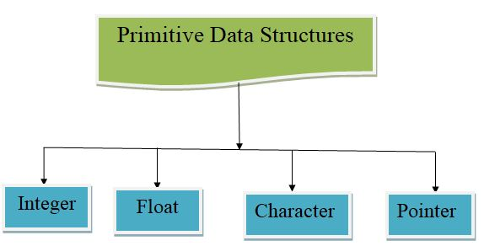
Primitive Data Structures

Slide 5
Contd…
Primitive data structures are basic structures and are directly operated upon by machine instructions.
Primitive data structures have different representations on different computers.
Integers, floats, character and pointers are examples of primitive data structures.
These data types are available in most programming languages as built in type.
Integer: It is a data type which allows all values without fraction part. We can use it for whole numbers.
Float: It is a data type which use for storing fractional numbers.
Character: It is a data type which is used for character values.
Pointer: A variable that holds memory address of another variable are called pointer.

Slide 6
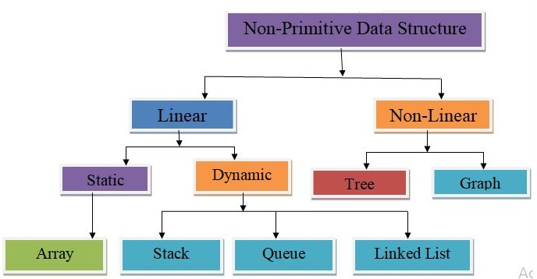
Non primitive Data Structures

Slide 7
Non primitive Data Structures
These are derived from primitive data structures.
The non-primitive data structures emphasize on structuring of a group of homogeneous or heterogeneous data items.
A Non-primitive data type is further divided into Linear and Non-Linear data structure.

Slide 8
Linear data structures
A data structure is said to be Linear, if its elements are connected in linear fashion by means of logically or in sequence memory locations.
There are two ways to represent a linear data structure in memory,
Static memory allocation
Dynamic memory allocation

Slide 9
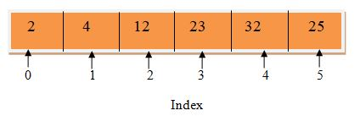
Static memory allocation
Array
In an array, elements in memory are arranged in continuous memory. All the elements of an array are of the same type. And, the type of elements that can be stored in the form of arrays is determined by the programming language.

Slide 10
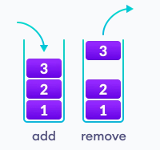
Dynamic memory allocation
Stack
In stack data structure, elements are stored in the LIFO principle. That is, the last element stored in a stack will be removed first.
In a stack, operations can be perform only from one end (i.e top)

Slide 11
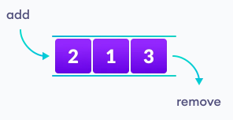
Contd…
Queue
Unlike stack, the queue data structure works in the FIFO principle where first element stored in the queue will be removed first.
In a queue, addition and removal are performed from separate ends.

Slide 12

Contd…
Linked List
In linked list data structure, data elements are connected through a series of nodes. And, each node contains the data items and address to the next node.

Slide 13
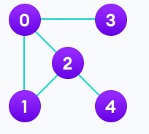
Non linear data structures
Unlike linear data structures, elements in non-linear data structures are not in any sequence.
Instead they are arranged in a hierarchical manner where one element will be connected to one or more elements.
Graph
In graph data structure, each node is called vertex and each vertex is connected to other vertices through edges.

Slide 14
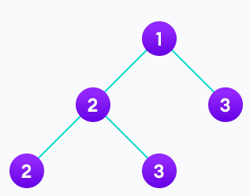
Contd…
Trees
Similar to a graph, a tree is also a collection of vertices and edges. However, in tree data structure, there can only be one edge between two vertices.

Slide 15
Operations on data structure
1. Create: The create operation results in reserving memory for program elements. This can be done by declaration statement. Creation of data structure may take place either during compile-time or run-time. malloc() function of C language is used for creation.
2. Destroy: Destroy operation destroys memory space allocated for specified data structure. free() function of C language is used to destroy data structure.
3. Selection: Selection operation deals with accessing a particular data within a data structure.
4. Updation: It updates or modifies the data in the data structure.
5. Splitting:- Splitting is a process of partitioning single list to multiple list.

Slide 16
Contd…
6. Traversing: Every data structure contains the set of data elements. Traversing the data structure means visiting each element of the data structure in order to perform some specific operation like searching or sorting.
7. Insertion: Insertion can be defined as the process of adding the elements to the data structure at any location.
If the size of data structure is n then we can only insert n-1 data elements into it.
A condition when a user tries to insert a new element in a data structure that does not have the needed space for new element is called Overflow.
8. Deletion: The process of removing an element from the data structure is called Deletion. We can delete an element from the data structure at any random location.
If we try to delete an element from an empty data structure then underflow occurs.

Slide 17
Contd…
9. Searching: The process of finding the location of an element within the data structure is called Searching. There are two algorithms to perform searching, Linear Search and Binary Search.
10. Sorting: The process of arranging the data structure in a specific order is known as Sorting. There are many algorithms that can be used to perform sorting, for example, insertion sort, selection sort, bubble sort, etc.
11. Merging: When two lists List A and List B of size M and N respectively, of similar type of elements, clubbed or joined to produce the third list, List C of size (M+N), then this process is called merging.

Slide 18
Algorithm
An algorithm is a process or a set of rules required to perform calculations or some other problem-solving operations especially by a computer.
The formal definition of an algorithm is that it contains the finite set of instructions which are being carried in a specific order to perform the specific task.
It is not the complete program or code; it is just a solution (logic) of a problem, which can be represented either as an informal description using a Flowchart or Pseudocode.

Slide 19
Characteristics of an Algorithm
The following are the characteristics of an algorithm:
1. Input: An algorithm has some input values. We can pass 0 or some input value to an algorithm.
2. Output: We will get 1 or more output at the end of an algorithm.
3. Unambiguity: An algorithm should be unambiguous which means that the instructions in an algorithm should be clear and simple.
4. Finiteness: An algorithm should have finiteness. Here, finiteness means that the algorithm should contain a limited number of instructions, i.e., the instructions should be countable.

Slide 20
Contd…
5. Effectiveness: An algorithm should be effective as each instruction in an algorithm affects the overall process.
6. Language independent: An algorithm must be language-independent so that the instructions in an algorithm can be implemented in any of the languages with the same output.

Slide 21
Dataflow of an Algorithm
1. Problem: A problem can be a real-world problem or any instance from the real-world problem for which we need to create a program or the set of instructions. The set of instructions is known as an algorithm.
2. Algorithm: An algorithm will be designed for a problem which is a step by step procedure.
3. Input: After designing an algorithm, the required and the desired inputs are provided to the algorithm.
4. Processing unit: The input will be given to the processing unit, and the processing unit will produce the desired output.
5. Output: The output is the outcome or the result of the program.

Slide 22
Example
Problem:- Add two numbers entered by the user:
Step 1: Start
Step 2: Declare three variables a, b, and sum.
Step 3: Enter the values of a and b.
Step 4: Add the values of a and b and store the result in the sum variable, i.e., sum= a+ b.
Step 5: Print sum
Step 6: Stop

Slide 23
Asymptotic Notations
The commonly used asymptotic notations used for calculating the running time complexity of an algorithm is given below:
Big oh Notation (О)
Big Omega Notation (Ω)
Theta Notation (θ)

Slide 24
Big oh Notation (O)
Big O notation is an asymptotic notation that measures the performance of an algorithm by simply providing the order of growth of the function.
This notation provides an upper bound on a function which ensures that the function never grows faster than the upper bound. So, it gives the least upper bound on a function so that the function never grows faster than this upper bound.
It is the formal way to express the upper boundary of an algorithm running time.
It measures the worst case of time complexity or the algorithm's longest amount of time to complete its operation.

Slide 25
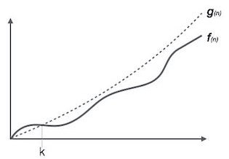
Graphical Representation
f(n) <= c. g(n) , c>0 , n>=k , k>=0

Slide 26
Big Omega Notation (Ω)
It basically describes the best-case scenario which is opposite to the big o notation.
It is the formal way to represent the lower bound of an algorithm's running time. It measures the best amount of time an algorithm can possibly take to complete or the best-case time complexity.
It determines what is the fastest time that an algorithm can run.
If we required that an algorithm takes at least certain amount of time without using an upper bound. It is used to bound the growth of running time for large input size.

Slide 27
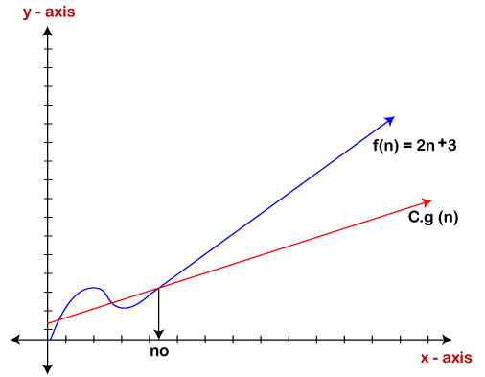
Graphical Representation
f(n) >= c. g(n)

Slide 28
Theta Notation (θ)
The theta notation mainly describes the average case scenarios.
It represents the realistic time complexity of an algorithm. Every time, an algorithm does not perform worst or best, in real-world problems, algorithms mainly fluctuate between the worst-case and best-case, and this gives the average case of the algorithm.
Big theta is mainly used when the value of worst-case and the best-case is same.
It is the formal way to express both the upper bound and lower bound of an algorithm running time.

Slide 29
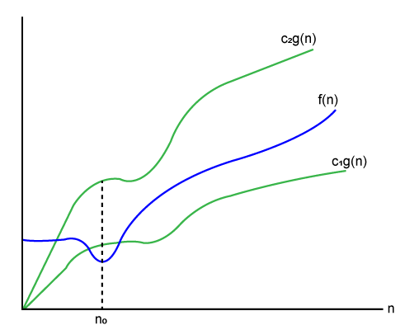
Graphical Representation
c1. g(n)<= f(n) <= c2. g(n)

Slide 30
Algorithm Complexity
The performance of the algorithm can be measured in two factors:
Time complexity: The time complexity of an algorithm is the amount of time required to complete the execution.
The time complexity of an algorithm is denoted by the big O notation.
Here, big O notation is the asymptotic notation to represent the time complexity.
The time complexity is mainly calculated by counting the number of steps to finish the execution.

Slide 31
Contd…
Space complexity: An algorithm's space complexity is the amount of space required to solve a problem and produce an output.
Similar to the time complexity, space complexity is also expressed in big O notation.
For an algorithm, the space is required for the following purposes:
To store program instructions
To store constant values
To store variable values
To track the function calls, jumping statements, etc.

Slide 32
Contd…
Auxiliary space: The extra space required by the algorithm, excluding the input size, is known as an auxiliary space.
The space complexity considers both the spaces, i.e., auxiliary space, and space used by the input.
Space complexity = Auxiliary space + Input size.

